Slide 1
LINEAR INTEGRATED CIRCUITS

Slide 2
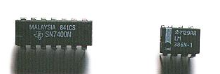
What is an Integrated Circuit?
Where do you use an Integrated Circuit?
Why do you prefer an Integrated Circuit to the circuits made by interconnecting discrete components?

Slide 3
Def: The “Integrated Circuit “ or IC is a miniature, low cost electronic circuit consisting of active and passive components that are irreparably joined together on a single crystal chip of silicon.

Slide 4
Applications of an Integrated Circuit
Communication
Control
Instrumentation
Computer
Electronics

Slide 5
Advantages:
Small size
Low cost
Less weight
Low supply voltages
Low power consumption
Highly reliable
Matched devices
Fast speed

Slide 6
Classification
Digital ICs
Linear ICs
Integrated circuits
Monolithic circuits
Thick &Thin film
Hybrid circuits
Bipolar
Uni polar
Pn junction
isolation
Dielectric
isolation
JFET
MOSFET
Classification of ICs

Slide 7
Chip size and Complexity
Invention of Transistor (Ge) - 1947
Development of Silicon - 1955-1959
Silicon Planar Technology - 1959
First ICs, SSI (3- 30gates/chip) - 1960
MSI ( 30-300 gates/chip) - 1965-1970
LSI ( 300-3000 gates/chip) -1970-1975
VLSI (More than 3k gates/chip) - 1975
ULSI (more than one million active devices are integrated on single chip)

Slide 8
SSI | MSI | LSI | VLSI | ULSI
< 100 active devices | 100-1000 active devices | 1000-100000 active devices | >100000 active devices | Over 1 million active devices
Integrated resistors, diodes & BJT’s | BJT’s and Enhanced MOSFETS | MOSFETS | 8bit, 16bit Microprocessors | Pentium Microprocessors

Slide 9
IC Package types
Metal can Package
Dual-in-line
Flat Pack

Slide 10
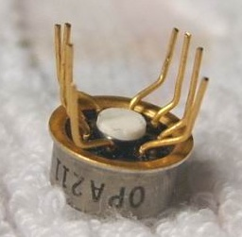
Metal can Packages
The metal sealing plane is at the bottom over which the chip is bounded
It is also called transistor pack

Slide 11
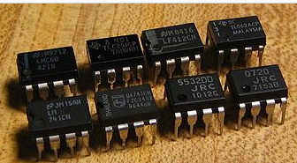
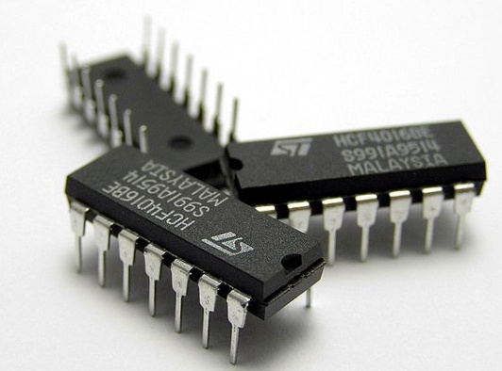
Dual-in-line Package
The chip is mounted inside a plastic or ceramic case
The 8 pin Dip is called MiniDIP and also available with 12, 14, 16, 20pins

Slide 12
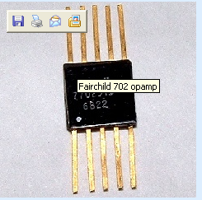
Flat pack
The chip is enclosed in a rectangular ceramic case

Slide 13
Selection of IC Package
Type | Criteria
Metal can package | Heat dissipation is important For high power applications like power amplifiers, voltage regulators etc.
DIP | For experimental or bread boarding purposes as easy to mount If bending or soldering of the leads is not required Suitable for printed circuit boards as lead spacing is more
Flat pack | More reliability is required Light in weight Suited for airborne applications

Slide 14
Packages
The metal can (TO)
Package
The Flat Package
The Dual-in-Line (DIP) Package

Slide 15
Temperature Ranges
Military temperature range : -55º C to +125º C (-55º C to +85º C)
Industrial temperature range : -20º C to +85º C (-40º C to +85º C )
Commercial temperature range: 0º C to +70º C (0º C to +75º C )

Slide 16
Manufacturer’s Designation for Linear ICs
Fairchild - µA, µAF
National Semiconductor - LM,LH,LF,TBA
Motorola - MC,MFC
RCA - CA,CD
Texas Instruments - SN
Signetics - N/S,NE/SE
Burr- Brown - BB

Slide 17
Operational Amplifier
The operational amplifier is a versatile device that can be used to amplify dc as well as ac input signals and was originally designed for computing such mathematical functions as addition, subtraction, multiplication and integration.
An “Operational amplifier” is a direct coupled high-gain amplifier usually consisting of one or more differential amplifiers and usually followed by a level translator and output stage.

Slide 18
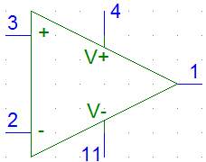
Op Amp
Positive power supply (Positive rail)
Non-inverting
Input terminal
Output terminal
Inverting input
terminal
Negative power supply
(Negative rail)

Slide 19
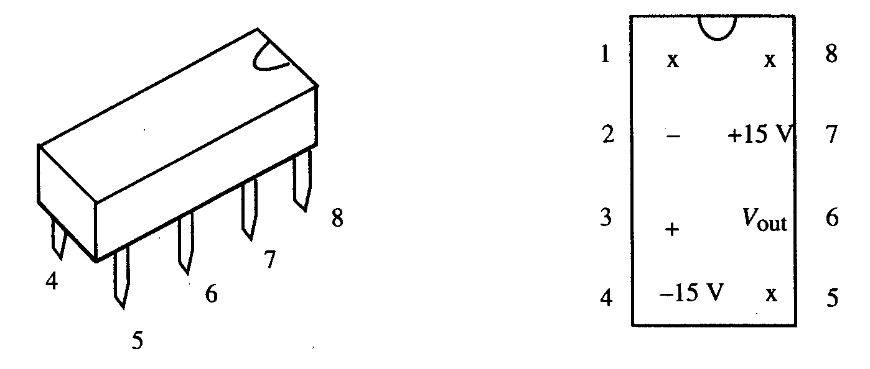
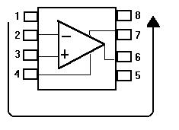
The Op-Amp Chip
741 Op Amp or LM351 Op Amp

Slide 20
Op-amp have 5 basic terminals(ie 2 i/p’s 1 o/p and 2 power supply terminals
The output goes positive when the non-inverting input (+) goes more positive than the inverting (-) input, and vice versa.

Slide 21
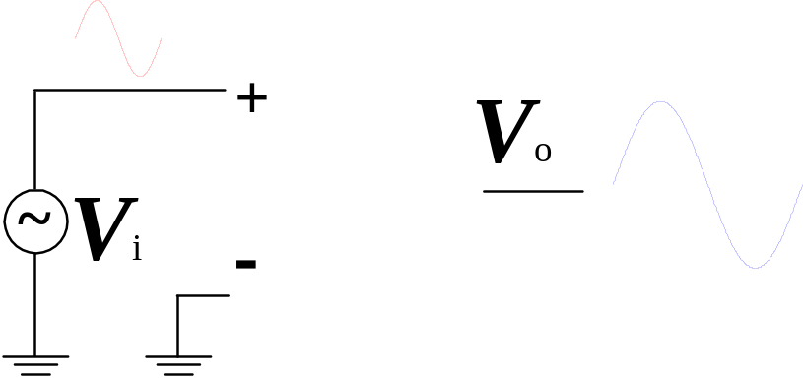
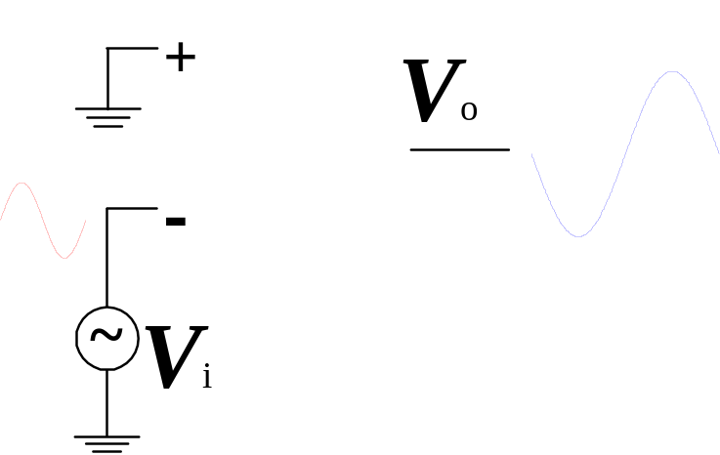
Single-Ended Input
+ terminal : Source
– terminal : Ground
0º phase change
+ terminal : Ground
– terminal : Source
180º phase change
Ref:080114HKN
Operational Amplifier

Slide 22
Basic Information of Op-Amp
Op-amps have five basic terminals, that is, two input terminals, one output terminal and two power supply terminals.

Slide 23
Basic Information of an Op-amp contd…
Power supply connection:
The power supply voltage may range from about + 5V to + 22V.
The common terminal of the V⁺ and V⁻ sources is connected to a reference point or ground.

Slide 24
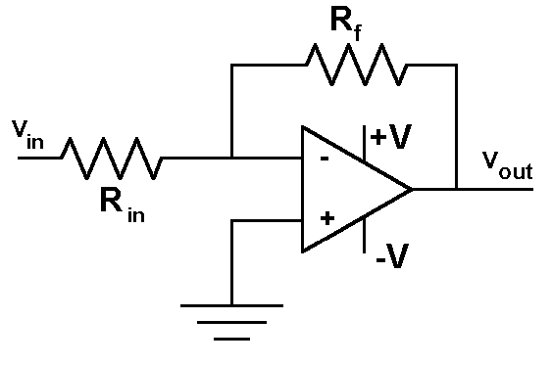
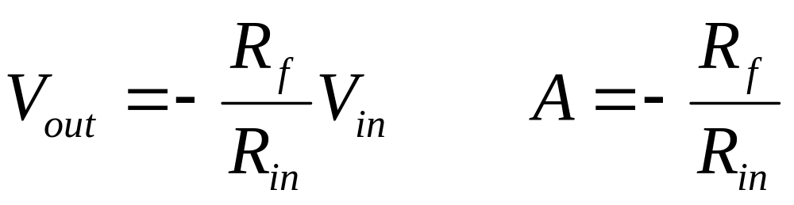
The Inverting Amplifier

Slide 25
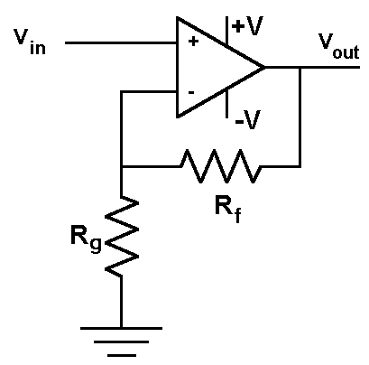
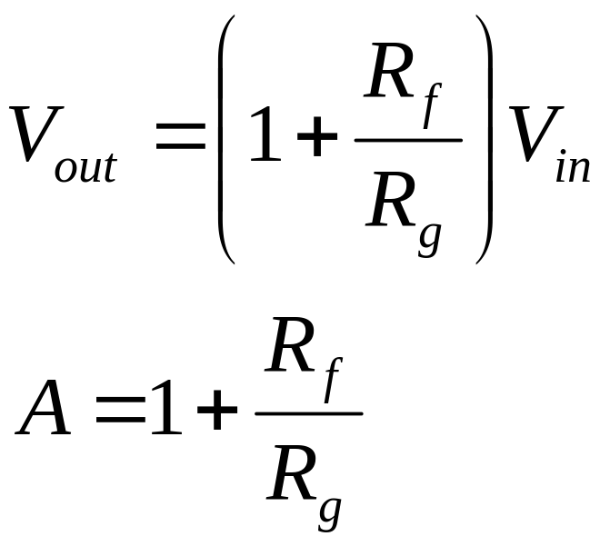
The Non-Inverting Amplifier

